Slide 1

Smart Warehouse Management for Agricultural Products
Team Member: Amit Prajapati Amisha Karia Dhruv Patel Lavina Budhwani
Guide:
Prof. Rujata Chaudhari Mr. Vinayak Narkar Co-Guide:
Prof. Nahid Shaikh

Slide 2

Content
Abstract Introduction Literature Review Problem Statement Project Scope
Use case diagram Prototype
Project Future Plan Summary References

Slide 3

Abstract
The basic idea behind our project is to give an online web based application and a web site to the farmers so that he can get the storage space faster without much wasting of time, money and efforts. Our system will also give a notification to the farmer regarding the expiry of stored goods in particular warehouse according to their lifespan. Our system will be a multilingual for understanding of farmers.

Slide 4
Introduction
It is a web based application that will allow the farmers
To store their crops in a warehouse.
Book space for their goods
Take decision about which warehouse selection using past data analysis and geographical location.

Slide 5
Literature Review
Igor Oliveira, Renato L. F. Cunha, Bruno Silva, Marco A. S. Netto, “A Scalable Machine Learning System for Pre-Season Agriculture Yield Forecast”
Proposed system:
They have implemented a Deep Neural Network (DNN) as their machine learning model to predict Pre-Season Agriculture Yield Forecast by using algorithms.
Pamidi Srinivasulu, R Venkat, M. Sarath Babu, K Rajesh, “Cloud Service Oriented Architecture (CSoA) for Agriculture through Internet of Things (IoT) and Big Data” Proposed System: The proposed work provides number of services that includes crop management, marketing, finance, e-commerce, web services via cloud, using various technologies like Big Data,Internet of Things (IoT), Cloud Computing, etc.

Slide 6
Literature Review
3)Shreya S. Bhanose, Kalyani A. Bogawar, Aarti G. Dhotre, Bhagyashree R. Gaidhani, “Crop and Yield Prediction Model”
Proposed System:
They have proposed a system that uses data mining algorithm like k-Means, k- Means++ and traditional k-Means for crop and disease prediction as well as predict crop water requirement.
4)S. Pudumala, E. Ramanujam, R. Harine Rajashreeń, C.Kavyań, T. Kiruthikań, J. Nishań, “ Crop Recommendation System for Precision Agriculture ”
Proposed System:
They have use research data of soil characteristics, soil types, crop yield data collection and suggests the farmers the right crop based on their site-specific parameters leading to increase in productivity.

Slide 7
Literature Review
5)Prof. D.S. Zingade, Omkar Buchade, Nilesh Mehta, Shubham Ghodekar, Chandan Mehta, “ Crop Prediction System using Machine Learning ”.
Proposed System:
The proposed project will integrate the data obtained from repository, weather department and by applying machine learning algorithm: Multiple Linear Regression, a prediction of most suitable crops according to current environmental conditions is made.

Slide 8
Problem Statement
Problem in Existing System:
Proposed Solution:
Offline Warehouse System.
Lot of Food get Wasted.
Wait in long queue for
Online Warehouse Booking System.
Auto Notification before expiry of grains.
booking
well as
Weather Analysis for crop prediction
Multilingual Feature
Suggestion for alternative storage of grains via informational videos.
An Online forum for problem solving
Warehouse space.
Waste of Time, efforts.
Language Barrier.
money as

Slide 9
Project Scope
➔ To give platform for Warehouse booking online
➔ To provide an application that is multilingual
➔ To help the farmers with Weather Analysis
➔ To provide some alternative solution videos for storage
➔ To provide Forum for dicussion

Slide 10

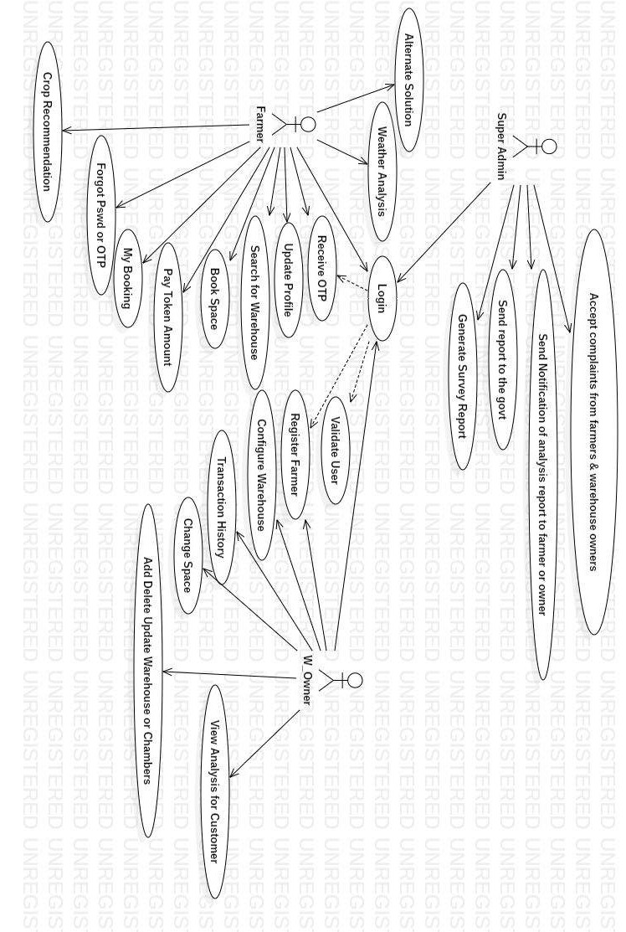
Use case

Slide 11
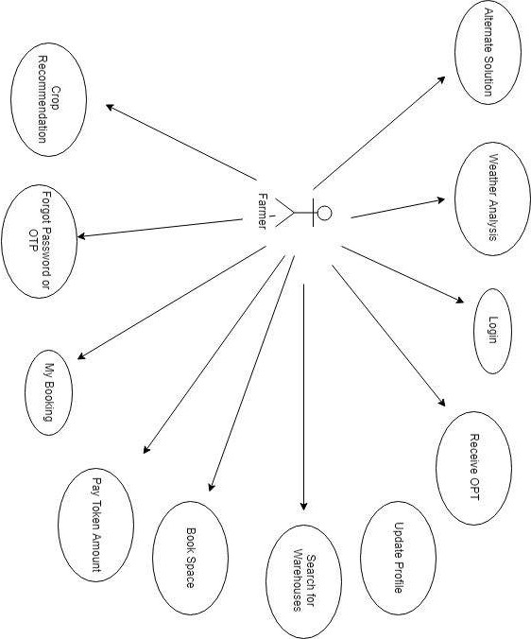
Use case - Farmer

Slide 12

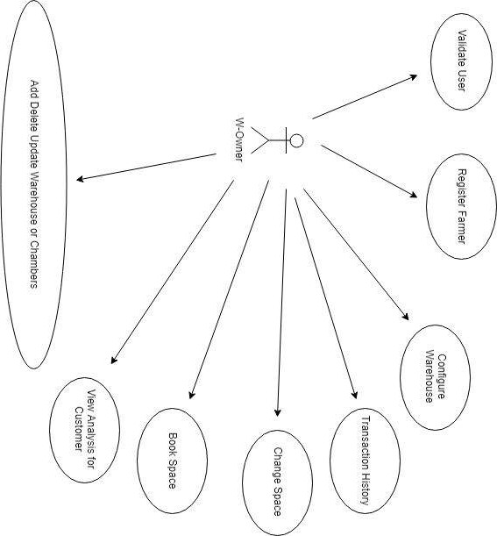
Use case - W-Owner

Slide 13
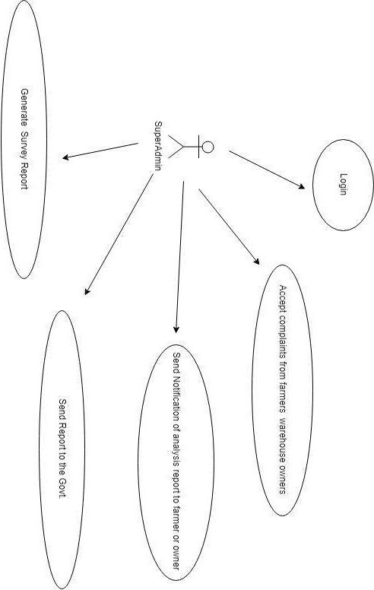
Use case - SuperAdmin

Slide 14
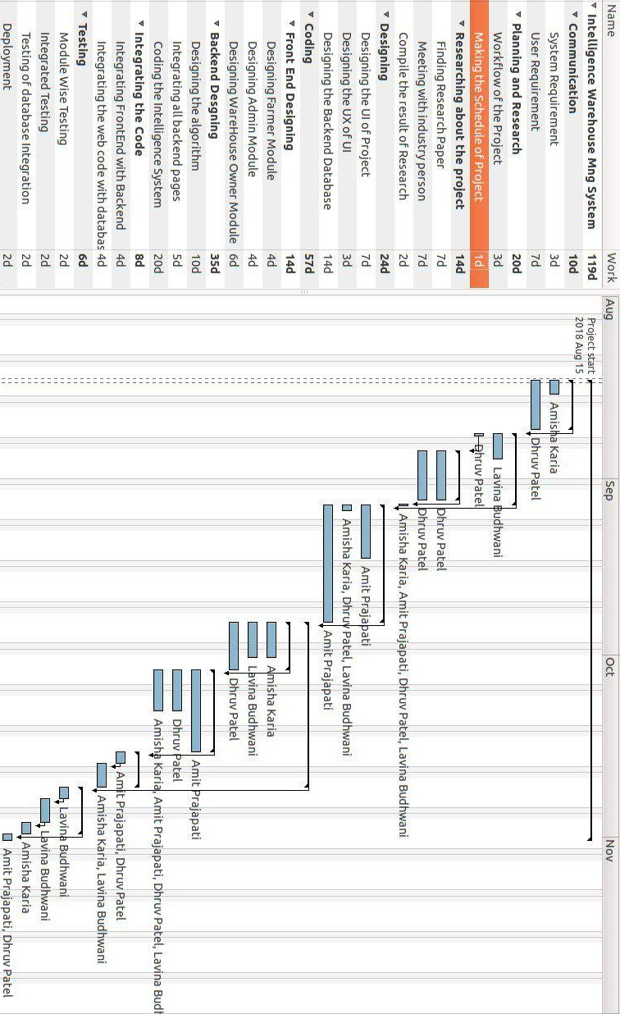
Project Future Plan

Slide 15

Prototype

Slide 16

Summary
The phases that we have achieved till yet are as follows-
➔ Research
➔ SRS Document preparation
➔ Analysis of Technology Stack
➔ Prototyping

Slide 17

References
Igor Oliveira, Renato L. F. Cunha, Bruno Silva, Marco A. S. Netto, “A Scalable Machine Learning System for Pre-Season Agriculture Yield Forecast”,arXiv:1806.09244v1
Pamidi Srinivasulu, R Venkat,M. Sarath Babu,K Rajesh,“Cloud Service Oriented Architecture (CSoA) for Agriculture through Internet of Things (IoT) and Big Data”,2017 International Conference on Electrical, Instrumentation and Communication Engineering (ICEICE2017).
Shreya S. Bhanose, Kalyani A. Bogawar, Aarti G. Dhotre,Bhagyashree R. Gaidhani,“Crop and Yield Prediction Model”,International Journal Of Advance Scientific Research And Engineering Trends,Volume 1 ||Issue 1 ||April 2016||ISSN (Online) 2456-0774.

Slide 18
References
[4]S.Pudumala, E.Ramanujam,R.Harine Rajashreeń, C.Kavyań, T.Kiruthikań, J.Nishań,“Crop Recommendation System for Precision Agriculture”,2016 IEEE Eighth International Conference on Advanced Computing (ICoAC).
Prof. D.S. Zingade,Omkar Buchade,Nilesh Mehta,Shubham Ghodekar,Chandan Mehta,” Crop Recommendation System for Precision Agriculture”,International Journal of Advance Engineering and Research Development Special Issue on Recent Trends in Data Engineering, Volume 4, Special Issue 5, Dec.-2017.
Link of the drive of paper referred https://drive.google.com/open?id=10a_-A85xa9Q93tmb40xGigKSSLf2H2Ij

Slide 19

Thank You

